Slide 1

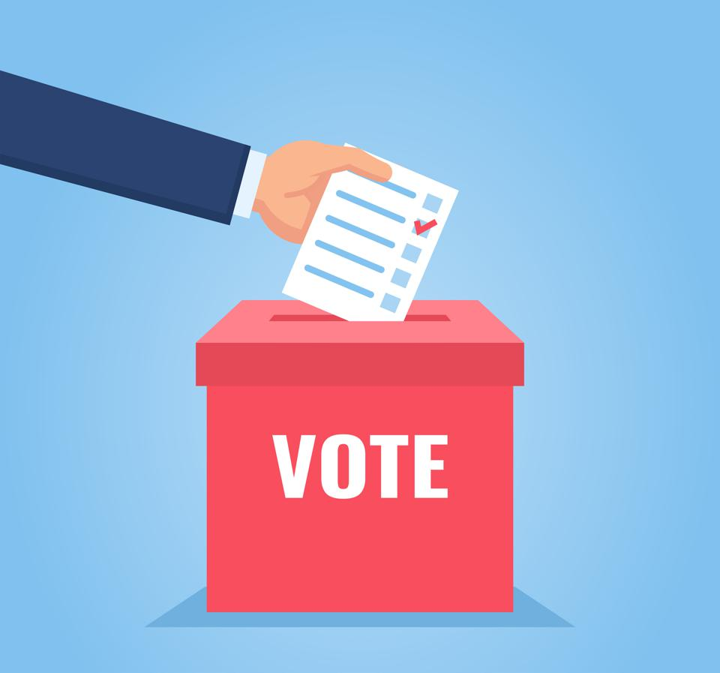
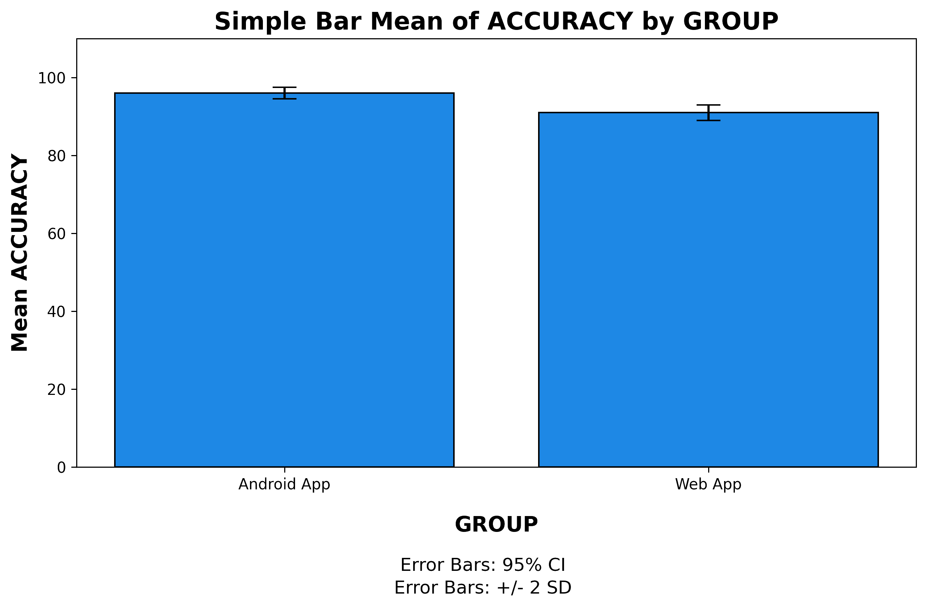
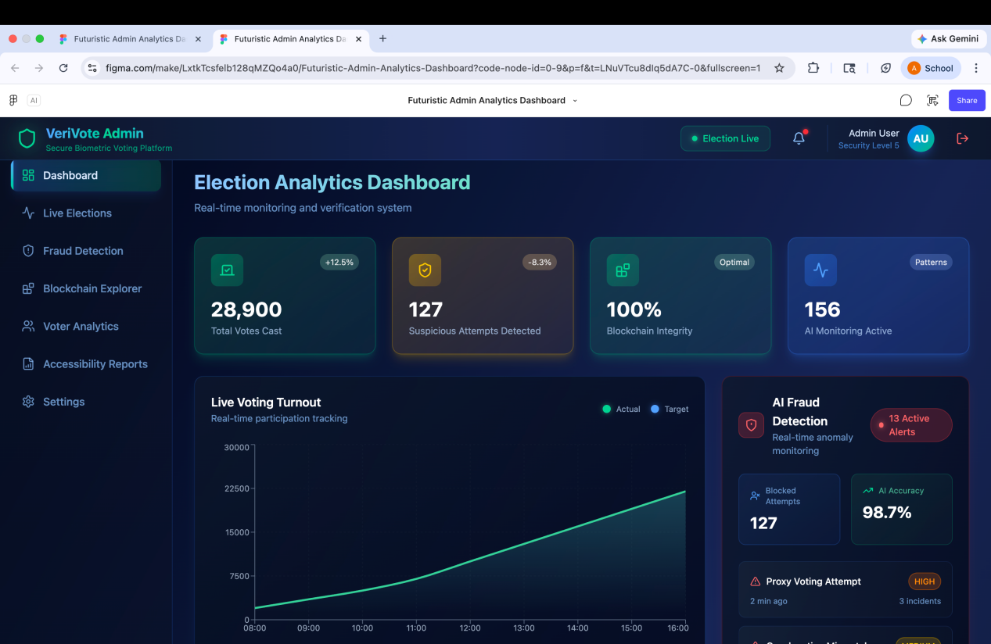
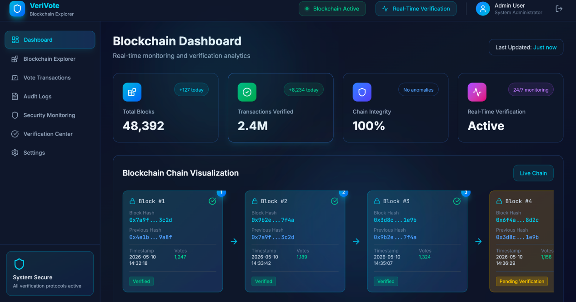
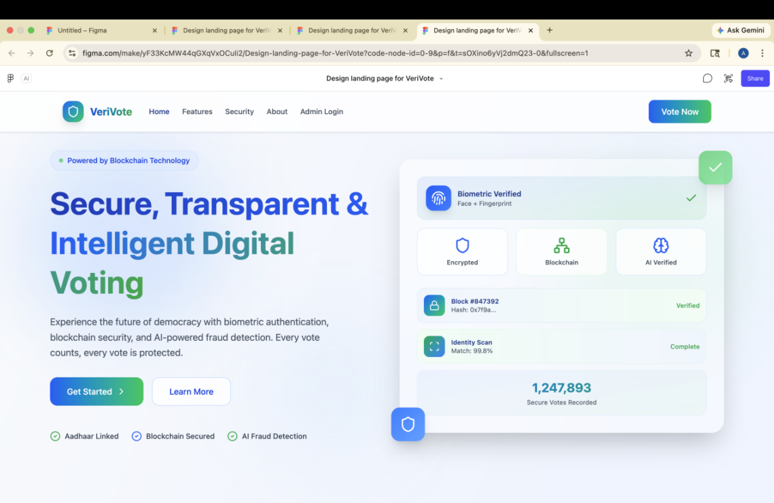
Student Name: Archana M
Project Guide: Dr. G.V SriRamakrishnan Reg. No: 192324192
A BLOCKCHAIN-BACKED MULTI-MODAL BIOMETRIC VOTING SYSTEM WITH AI FRAUD DETECTION
INTRODUCTION
Vortura is a secure blockchain-based electronic voting platform designed to improve transparency, security, and reliability in digital elections.
The system uses multi-modal biometric authentication, including facial recognition and fingerprint verification, to ensure secure voter identity validation.
Blockchain technology stores encrypted voting records in immutable blocks, ensuring tamper-proof and transparent vote management.
An AI-based fraud detection module identifies suspicious activities such as proxy voting, multiple login attempts, and biometric spoofing attacks.
The platform provides multilingual voice-guided accessibility features for rural, elderly, and differently-abled users.
Fig. 1 Digital Voting System
MATERIALS AND METHODS
AI FRAUD DETECTION
• Device Validation
• Geo-location Verification
• Spoof Detection
USER REGISTRATION
Aadhaar & Personal Information Submission
OTP AUTHENTICATION
Mobile Number Verification
MULTI- MODEL BIOMETRIC VERIFICATION
• Face Recognition
• Fingerprint Authentication
SECURE VOTING DASHBOARD
Display of contestants
Vote Selection
Review and Confirmation of Vote
VOTE ENCRYPTION & BLOCKCHAIN STORAGE
Vote encrption using cryptography
Hash Generation
Vote Stored as a block in blockchain
Immutable and Tamper- proof record
ADMIN MONITORING & ANALYTICS
Real-time election monitoring
AI- based fraud alerts
Dashboard nd analytics reports
Transparent and auditable process
BLOCK CHAIN VERIFICATION
Block Chain consenses verification
Successful vote confirmation
Generation of anonymous digital receipt
Fig . 2 Operational Flow of the Blockchain-Based Voting System
RESULTS
Table. 1 Independent T-test Group Statistics
Fig. 5 Blockchain Chain Visualization
 | GROUP | N | Mean | Std. deviation | Std. Error Mean
Accuracy | Web App | 50 | 83.9231 | 4.46209 | 1.23756
 | Android App | 50 | 91.0769 | .95407 | .26461
Fig . 3 Accuracy comparison graph between by Group
Fig. 4 Landing Page
Fig. 7 Admin Dashboard
DISCUSSION AND CONCLUSION
Comparative analysis showed that both the Android and Web applications of Vortura effectively support secure digital voting using blockchain, biometrics, and AI-based fraud detection.
The Android application demonstrated better speed, response time, usability, and lower error rates due to optimized mobile biometric integration. The Web application provided enhanced administrative control, real-time monitoring, and transparent blockchain analytics.
SPSS mean analysis indicated higher user satisfaction and efficiency for the Android application, while the Web platform showed better scalability and accessibility.
Overall, Vortura improved election security, transparency, and reliability through blockchain storage, biometric authentication, and AI-powered fraud detection.
BIBLIOGRAPHY
H. O. Ohize, “Blockchain for Securing Electronic Voting Systems: A Survey of Security Requirements and Existing Systems,” Cluster Computing, vol. 28, pp. 1–28, 2025.
M. Jain, “E-Voting System Using Machine Learning, Blockchain, and Fraud Detection,” International Journal on Science and Technology, vol. 16, no. 2, pp. 1–9, 2025.
B. Sujatha, Y. Ganesh, N. Leelavathy, R. Tamilkodi, S. Venkatesh, B. Sandhya, and T. S. Kowshik, “Blockchain-Powered E-Voting: A Novel Approach to Secure Voter Authentication, Online Voting and Election Automation,” Indian Journal of Science and Technology, vol. 17, no. 47, pp. 4948–4958, 2024.
M. Sharp, “Blockchain-Based E-Voting Mechanisms: A Survey and a Novel System,” Blockchains, vol. 4, no. 4, pp. 21–39, 2024, blockchains4040021.
S. S. Taher, “Advanced Fraud Detection in Blockchain Transactions,” Engineering, Technology & Applied Science Research, vol. 14, no. 2, pp. 14567–14575, 2024.

